Slide 1
Money & the financial and monetary systems
Aditi Chaubal
aditi@hss.iitb.ac.in
HS101 – Economics (Macroeconomics) - 2019

Slide 2
Overview
Money
Evolution and functions
Components of money supply
Demand for money
Interest rates (or the price of money)
Financial system: Components and functions
Financial Institutions: Financial markets and intermediaries - stock markets and banks
The flow of funds
Banks and money supply
Financial assets and the stock markets
Returns on assets
Efficient markets hypothesis
HS101 – Economics (Macroeconomics) - 2019

Slide 3
Money
History
Barter → Commodity money (intrinsic value of commodities) → Modern money (fiat or paper money)
Fiat money is money without intrinsic value which is used as money due to government decree
Money is anything that serves as a commonly accepted medium of exchange. It is the set of assets in an economy that people regularly use to buy goods and services from other people.
Functions:
Medium of exchange
Store of value
Unit of account
HS101 – Economics (Macroeconomics) - 2019

Slide 4
Functions of money
Medium of exchange
An item which buyers give to sellers when they purchase goods and services; readily acceptable as payment
Store of Value
An item which people can use to transfer purchasing power from the present to the future
Unit of Account
It serves as the yardstick people use to post prices and record debts
Liquidity is the ease with which an asset can be converted into the economy’s medium of exchange
Liquid assets vs. illiquid assets
HS101 – Economics (Macroeconomics) - 2019

Slide 5
Important terms
Term | Definition
Currency in circulation | = Notes in circulation, rupee coins and small coins
Currency with public | = Currency in circulation – cash held by banks
Demand deposits with banking system | = All liabilities payable on demand or ‘checking deposits’ (E.g. demand drafts, current deposits, etc.)
‘Other’ deposits with RBI | = Deposits from foreign central banks, multilateral institutions, financial institutions
Time deposits with the banking system | = Deposits which are payable otherwise than on demand (E.g. fixed deposits, recurring deposits, cash certificates, etc.)
HS101 – Economics (Macroeconomics) - 2019

Slide 6
Important terms
Term | Definition
Bank credit to the commercial sector (indicator of real sector activity) | = [(RBI) + (other banks)]’s credit to the commercial sector = [(Investments in bonds/shares of financial institutions, loans to them and holdings of internal bills purchased and discounted) + (banks’ loans and advances to the commercial sector (including scheduled commercial banks’ food credit) and banks’ investments in “other approved” Securities)]
Net foreign assets of the banking sector | = RBI’s net foreign exchange assets + net foreign currency assets of the banking system = RBI’s holdings of foreign currency assets and gold + Banks’ holdings of foreign currency assets net of i) their holdings of non-resident repatriable foreign currency fixed deposits which is presently defined to include FCNR deposits and ii) overseas foreign currency borrowings.
Net bank credit to the government | = Net RBI credit to the Government (i.e., Net RBI Government Credit to the Centre + Net RBI Credit to State Governments) + Other banks’ credit to the Government

Slide 7
Monetary and liquidity aggregates in India
Reserve Money M₀ | = Currency in circulation + Bankers’ deposits with the RBI + ‘Other’ deposits with the RBI
Narrow money M₁ | = Currency with the public + Demand deposits with the banking system + ‘Other’ deposits with the RBI.
Broad money M₃ | = M1 + Time deposits with the banking system
M₂ | = M1 + Savings deposits of post office savings banks.
M₄ | = M3 + All deposits with post office savings banks (excluding National Savings Certificates)
New monetary aggregates (NM₁, NM₂ and NM₃) are also reported in accordance with the recommendations of the Working Group on Money Supply led by Dr. Y.V. Reddy in 1998. The NM₂ and NM₃ aggregates are based on the concept of residency and the deposits of non-resident Indians (NRIs).
Liquidity aggregates (L₁, L₂, L₃) include currency with the public, deposits of residents, term deposits, certificates of deposit, and public deposits of non-banking financial companies (NBFCs)

Slide 8
Money supply per unit of GDP
Ref: RBI Handbook of Statistics on the Indian Economy, November 2019

Slide 9
The demand for money
Recall functions of money
The cost of holding money (opportunity cost)
Interest foregone from not holding other assets
Close to the short-term interest rate
Holding money is costly: Lower yield than other safe assets
What is the nominal interest rate on holding currency?
HS101 – Economics (Macroeconomics) - 2019

Slide 10
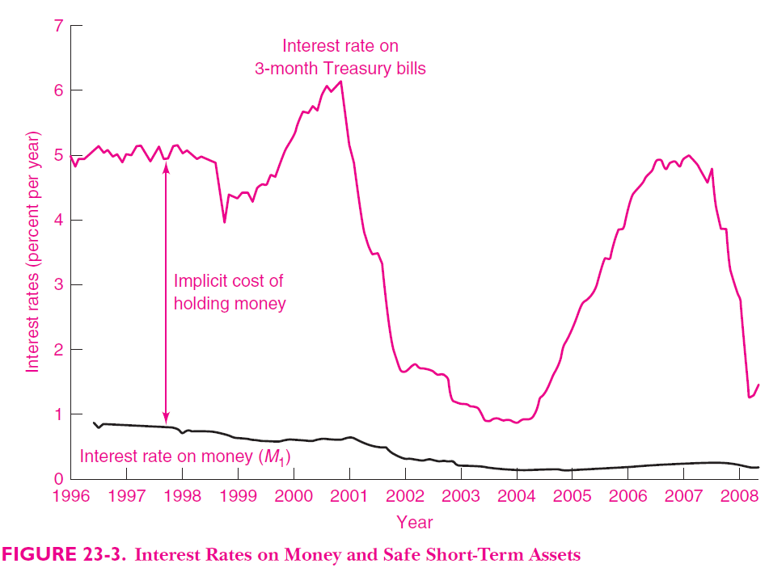
The cost of holding money Ref: Samuelson & Nordhaus: Economics, 19th Ed
?

Slide 11
Sources of Money Demand
Transactions demand for money: The need to have money to pay for purchases, or transactions, of goods, services, and other items (as a medium of exchange)
If all prices and incomes double…
Transaction demand for money = ?
Recall: Changes in money demand due to changes in interest rates (liquidity preference theory)
Asset demand for money: Demand for money as a store of value
Primitive or unreliable financial systems, countries facing hyperinflation, near zero interest rates, etc.
HS101 – Economics (Macroeconomics) - 2019

Slide 12
Interest rates
Price of money
Amount of interest paid per unit expressed as a percentage of the amount borrowed
Interest rate on: savings account, loan, mortgage etc.
Types of interest rates based on characteristic of loan:
Term or maturity of loan (length of time until the loan is to be paid off): short-term vs. long-term securities
HS101 – Economics (Macroeconomics) - 2019

Slide 13
Interest rates
Risk (riskless vs. speculative):
Safe - Government securities (‘riskless’ interest rate)
Intermediate risk - borrowings of creditworthy corporations, states, etc.
Risky (Significant chance of default or nonpayment) – borrowings of companies close to bankruptcy, countries with large overseas debts, political instability, etc.
3 factors – term, risk and liquidity – result in different financial instruments and interest rates
HS101 – Economics (Macroeconomics) - 2019

Slide 14
Recall: Real vs. nominal interest rates
Nominal interest rate, i: measures yield per Rupee invested
Does not measure returns in real terms (of goods and services)
Real interest rate, r : nominal interest rate corrected for inflation i.e. measures the quantity of goods received tomorrow for goods foregone today
r = i – Inflation rate (Fisher effect)
HS101 – Economics (Macroeconomics) - 2019

Slide 15
Financial system – Components and Functions
Finance involves a vast worldwide banking system, securities markets, insurance companies, and other financial instruments.
Financial system: Circulatory system which links goods, services and finance in domestic and international markets.
Smooth functioning aids growth while system failures result in slowdowns and/or recessions.
Group of institutions which help match an individual’s saving with another’s investment
Financial system = markets + firms + other institutions carrying out the financial decisions of households, businesses and governments
HS101 – Economics (Macroeconomics) - 2019

Slide 16
Financial system – Components and Functions
Functions of a financial system:
Transfers resources across time, sectors and regions: Allows investment to be devoted to their most productive uses. E.g. international finance, loans, retirement savings
Manages risk for the economy akin to resource transfer: Risk management is like a resource transfer wherein the system moves the risk from the people or sectors that need to reduce their risk and transfers it to others who are better equipped to handle them. E.g. insurance policy.
Pools and subdivides funds depending on the need of the individual saver or investor. E.g. Single investor wanting to invest in a diverse portfolio (mutual funds) or corporation making large and risky investments.
Performs the function of a clearing house which facilitates payments between buyers and sellers. This functions allows rapid transfer of funds across the world.
HS101 – Economics (Macroeconomics) - 2019

Slide 17
Financial system – Components and Functions
Financial intermediaries (FIs): Institutions which provide financial services and products; financial institutions through which savers can indirectly provide funds to borrowers
Financial intermediaries (FIs) differ from other businesses as their assets are largely financial in nature (unlike firms with plants and equipment). E.g. banks, insurance companies, etc.
Types of FIs depend on their function: (i) banks, (ii) companies which offer insurance policies or investment opportunities for retirement periods (insurance companies, pension funds), and (iii) companies which pool and subdivide securities (mutual funds, etc.).
Purpose of financial intermediation: Transform illiquid assets into liquid assets which small investors can buy. Process in which assets are bought, repackaged and resold several times.
HS101 – Economics (Macroeconomics) - 2019

Slide 18
Financial institutions
Financial intermediaries: Institutions which provide financial services and products
Banks
Mutual funds
Insurance companies
Other NBFCs
Financial markets are the institutions through which savers can directly provide funds to borrowers.
Stock markets (equity)
Bond markets (debt)
HS101 – Economics (Macroeconomics) - 2019

Slide 19
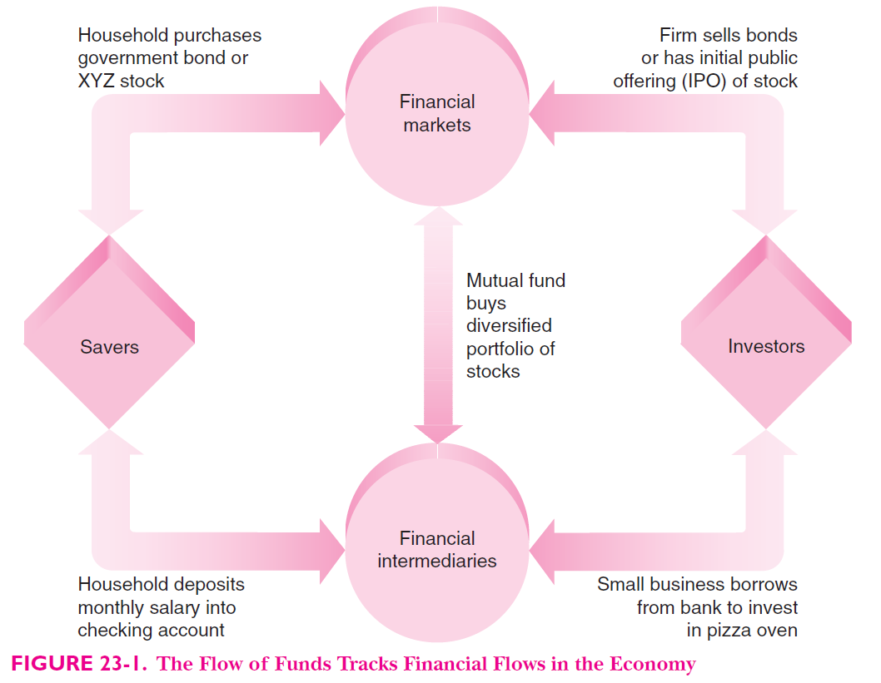
Ref: Samuelson & Nordhaus: Economics, 19th Ed

Slide 20
Financial Intermediaries
Most important FIs are commercial banks
Commercial banks: Entities which take deposits of funds from households, firms and other groups and lend to businesses and/or individuals who want to borrow
Banks pay depositors interest on savings and charge higher interest on the loans (difference covers costs and ensuing profits)
Banks provide medium of exchange (money) used to engage in transactions
Mutual funds: Institution which sells shares to the public and uses the proceeds to buy a portfolio of stocks, bonds or both (store of value)
Primary advantage of MF: diversified portfolio (and risk)
The shareholder of the MF accepts the risk and the associated return on the portfolio

Slide 21
Financial assets
Claims of one party against another
Types of financial assets:
US | India
Money and its components | Currency and deposits
Savings accounts | Investment – Government securities and other securities (Mutual funds)
Credit market instruments | Loans and advances
Money market and mutual funds | Small savings
Pension funds | Life fund
 | Provident fund
 | Other claims

Slide 22
Banking sector in India
2nd Schedule to the RBI Act 1934; Banking Regulation Act, 1949
Scheduled banks = Scheduled commercial banks +Scheduled cooperative banks
India has a total of 162 scheduled commercial banks
= 21 Public sector banks + 40 Private sector banks
+ 56 Regional rural banks (RRBs) + 45 private foreign banks
Scheduled cooperative banks = Scheduled state coop. banks (20) + Scheduled urban coop. banks (54)
HS101 – Economics (Macroeconomics) - 2019

Slide 23
Indian banking sector
Public sector banks = 19 nationalized banks + (SBI & associates)
State Bank of India → set up by the Government in 1955; 5 subsidiaries (state-associated) + BMB
Nationalisation of banks:
1969: Banking Companies (Acquisition and Transfer of Undertakings) Ordinance (later Act) → 14 banks nationalized (‘to serve better the needs of development of the economy in conformity with national policy objectives’)
1980: 6 private sector banks nationalized (‘further control the heights of the economy, to meet progressively, and serve better, the needs of the development of the economy and to promote the welfare of the people in conformity with the policy of the State’)
HS101 – Economics (Macroeconomics) - 2019

Slide 24
Indian banking sector
Private sector banks = 22 Private banks + 3 local area banks + 10 small finance banks + 7 payments banks
Local area banks (3): First set up in 1996, they serve 2 or 3 contiguous districts for mobilizing local savings and channelizing them for local investments
Small finance banks (10)
Primary objective of lending to small business units, small and marginal farmers, micro and small industries and other unorganised sector entities, through high technology-low cost operations.
Payments banks (7)
Primary objective to provide payments/remittance services to migrant labour workforce, low income households, small businesses, other unorganised sector entities and other users.
HS101 – Economics (Macroeconomics) - 2019

Slide 25
Indian banking sector
RRBs (45): Set up following the RRB Act of 1976, they are jointly owned by the central government, state government and a sponsor scheduled commercial bank (Equity share 50:15:35)
Local familiarity of cooperatives and professionalism and resource base of commercial banks
Specialized rural financial institutions for development of rural areas
E.g. Allahabad UP Grameen Bank, Arunachal Pradesh Rural Bank, Kerala Gramin Bank etc.
HS101 – Economics (Macroeconomics) - 2019

Slide 26
Indian banking sector
Non-banking financial sector: NBFCs + development financial institutions (DFIs) + insurance sector
NBFCs: Housing finance company, equipment leasing company, investment company, loan company, etc. [11,469 registered with the RBI as of Feb 2018 (81 deposit taking)].
DFIs: Initiative of the government to fund activities of long gestation NOT traditionally covered by commercial banks
Main role varies from direct lending (EXIM) to provision of refinancing (NABARD, SIDBI)
4 DFIs: National Bank for Agriculture and Rural Development (NABARD), EXIM Bank, National Housing Bank, Small Industries Development Bank of India (SIDBI)
HS101 – Economics (Macroeconomics) - 2019

Slide 27
Indian banking sector
Insurance sector: Till 1999, sector monopolized by Life Insurance Company (LIC), General Insurance Corporation (GIC), United India Assurance (UIA), New India Assurance, Oriental Insurance Company, National Insurance Company
IRDAI Act 1999 following post-liberalization economic reforms
Allow private sector companies to promote insurance companies
Allow foreign promoters
Government to vest its regulatory powers on an independent regulatory body answerable to Parliament – Insurance Regulatory and Development Authority (IRDA)
53 insurance companies in India
HS101 – Economics (Macroeconomics) - 2019

Slide 28
Banks and the supply of Money
Fundamentally, banks are businesses organized to earn profits for their owners.
A commercial bank provides certain services for its customers and in return receives payments from them.
A balance sheet is a statement of a firm’s financial position at a point in time. It lists the assets and liabilities of the firm.
Assets => items that the firm owns
Liabilities => items that the firm owes
HS101 – Economics (Macroeconomics) - 2019

Slide 29
Banks and the supply of Money
Bank balance sheets similar to firms
Unique feature unlike firms: asset called Reserves
Reserves: special category of bank assets regulated by the central bank
Reserves = currency held by the bank + deposits with the central bank
Purpose:
(historically) to pay depositors
(today) to meet reserve requirements
Reserves are deposits which banks receive and are not loaned out
HS101 – Economics (Macroeconomics) - 2019

Slide 30
Banking systems: evolution
Recall: Goldsmiths and moneylenders → Modern banking system
100% reserve banking system: Banks do not influence money supply as they hold all the deposits as reserves. No money creation takes place.
Fractional reserve banking: Banks hold a fraction of the money deposited as reserves and lend out the rest; thus influencing money supply and creating money.
Modern banking system: Fractional reserve banking with additional elements of buying and selling of reserves by the central bank, reserve requirements, etc.
HS101 – Economics (Macroeconomics) - 2019

Slide 31
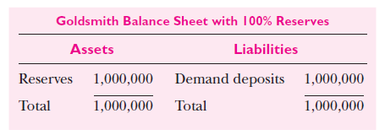
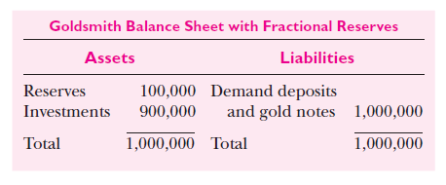
100% vs. Fractional banking balance sheets Ref: Samuelson & Nordhaus: Economics, 19th Ed (Values in USD)
HS101 – Economics (Macroeconomics) - 2019

Slide 32
Consolidated balance sheet of scheduled commercial banks (2017) (Rs. Crore)
ASSETS |  | LIABILITIES
Cash in hand | 622,962 | Capital | 9,92,919
Balances with RBI | 61,82,456 | Reserves and Surplus | 1,01,07,865
Balances with banks in India | 10,08,669 | Deposits | 11,11,14,481
Money at call and short notice | 36,93,255 | Borrowings in and outside India | 1,28,07,079
Balances with banks outside India | 26,72,347 | Other liabilities & provisions | 67,23,721
Investments in and outside India | 365,22,836 | Total Liabilities | 14,17,46,065
Advances in and outside India | 811,61,090
Fixed Assets | 15,06,854
Other assets | 83,75,596
Total assets | 141746065
(Ref: Statistical Tables relating to Banks in India, RBI)
HS101 – Economics (Macroeconomics) - 2019

Slide 33
Money multiplier
How do banks create money?
Assume a bank has a deposit of Rs.100. Suppose the bank maintains 10% of its deposits as reserves.
1st lending = Rs. 90 (=0.9 x 100)
2nd lending = Rs. 81 (=0.9 x 90 = 0.9 x (0.9 x100))
3rd lending = Rs. 72.90 (=0.9 x 81= 0.9 x (0.9)²x100)
…
Thus, total money created (total deposits in the economy) by the Rs.100 deposit is Rs.1000.
HS101 – Economics (Macroeconomics) - 2019

Slide 34
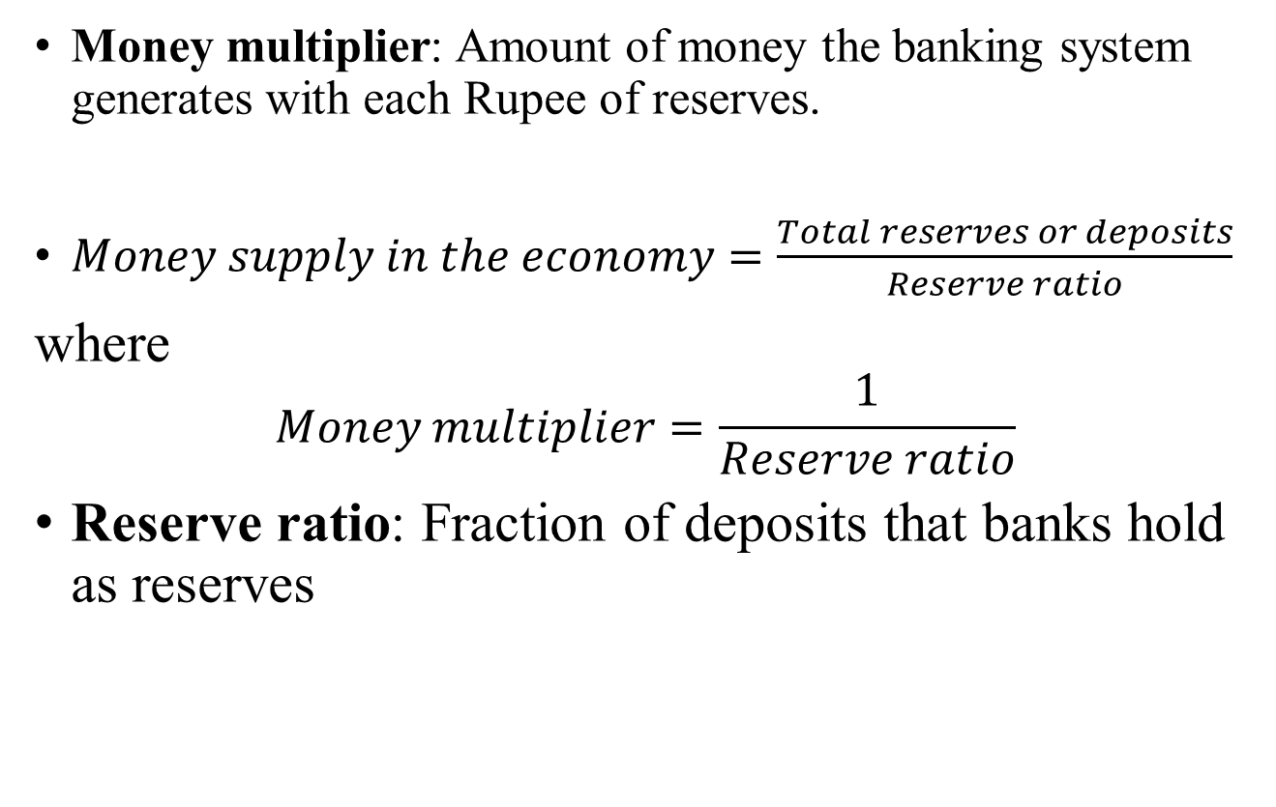
Money multiplier
Money multiplier: Amount of money the banking system generates with each Rupee of reserves.
$Money supply in the economy=\frac{Total reserves or deposits}{Reserve ratio}$
where
$$Money multiplier=\frac{1}{Reserve ratio}$$
Reserve ratio: Fraction of deposits that banks hold as reserves
HS101 – Economics (Macroeconomics) - 2019

Slide 35
Financial Markets
Stock market
A stock represents a claim to partial ownership in a firm and is therefore, a claim to the profits that the firm makes.
The sale of stock to raise money is called equity financing. A stock is an equity instrument.
Compared to bonds, stocks offer both higher risk and potentially higher returns.
The most important stock exchanges in India are the Bombay Stock Exchange (BSE) and the National Stock Exchange (NSE)
HS101 – Economics (Macroeconomics) - 2019

Slide 36
Bond market
A bond is a certificate of indebtedness that specifies obligations of the borrower to the holder of the bond.
It identifies the time at which the loan is repaid (date of maturity) and the rate of interest which will be paid periodically till the loan matures.
Raising money through bonds (debt instrument) is called debt finance.
HS101 – Economics (Macroeconomics) - 2019

Slide 37
Bond market
Characteristics of a Bond
Term: The length of time until the bond matures. Long-term bonds are riskier than short-term bonds (duration of repayment). Higher return on long-term bonds.
Credit Risk: The probability that the borrower will fail to pay some of the interest or principal. Failure to pay is called a default. Higher interest rate on riskier bonds (government bond vs. bond issued by a firm).
Tax Treatment: The way in which the tax laws treat the interest on the bond. India: Tax-free vs. tax-saving bonds
HS101 – Economics (Macroeconomics) - 2019

Slide 38
The Stock Market – Important aspects
Stock market: Place where shares in publicly owned companies are traded
Rate of return: total Rupee gain from a security measured as a percentage of the price at the beginning of the period
Capital gain or loss: Increase or decrease in value of assets between 2 periods
Risk: Variability of returns on an investment i.e. uncertainty of rate of return on an asset
Measure of risk: Standard deviation of returns
Low risk: Risk averse
High risk: Risky or risk taker
Relation between risk and return?
HS101 – Economics (Macroeconomics) - 2019

Slide 39
Risk Management
Individuals can reduce risk by:
Buying insurance
Diversifying risk
Accept a lower return on investments
Insurance: A person facing a risk pays a fee to an insurance company, which in return agrees to accept all or part of the risk.
Diversification: Reduction of risk achieved by replacing a single risk with a large number of smaller unrelated risks. Firm-specific risk is risk that affects only a single company. Market risk is risk that affects all companies in the stock market. Diversification cannot remove market risk.
Lower rate of return: Relation between risk and return
HS101 – Economics (Macroeconomics) - 2019

Slide 40
Stock markets in India
Purpose of markets: Price discovery & risk management
19 recognized stock markets
Stock price index: Weighted average of prices of a basket of company stocks
SENSEX : basket of 30 companies
Nifty 50 : basket of 50 companies
Stocks: Long-term vs. short-term investment
HS101 – Economics (Macroeconomics) - 2019

Slide 41
The Stock Market – Important aspects
Some major developments:
Regulator for stock markets: Securities Exchange Board of India established in 1992 to regulate and develop the securities markets
NSE was set up as India’s first electronic trading platform in 1993
National Securities Depository Ltd (NSDL) and Central Depository Services Ltd (CDSL) were established to facilitate paperless trading. They are electronic depositories for NSE and BSE respectively to hold securities electronically in de-materialized format
HS101 – Economics (Macroeconomics) - 2019

Slide 42
S&P BSE Index (Jan 1991-Oct 2018)
Ref: https://www.bseindia.com/sensexview/IndexArchiveData.aspx?expandable=3
HS101 – Economics (Macroeconomics) - 2019

Slide 43
S&P BSE Index (Jan 2016-Oct 2018)
Ref: https://www.bseindia.com/sensexview/IndexArchiveData.aspx?expandable=3
HS101 – Economics (Macroeconomics) - 2019

Slide 44
The Stock Market – Important aspects
Bubbles & crashes
Investors: (i) invest based on firm foundations, (ii) invest by trying to outguess market psychology
Firm foundation approach (safe approach): Assets are valued based on their intrinsic value. E.g. intrinsic value of stock
Keynesian view: Investors worry about market psychology and speculate about future value
Speculative bubbles: occur when speculative prices are driven far beyond the intrinsic value of the asset i.e. when prices rise only because people think they will rise further in future (Reverse of Keynes’ view)
Speculative bubbles always lead to crashes and sometimes lead to economic panic
Most famous bubbles?
HS101 – Economics (Macroeconomics) - 2019

Slide 45
The Efficient Markets Hypothesis (EMH)
Efficiency (in finance): Information is quickly absorbed
Efficient financial market: Market where all new information is quickly understood by market participants and becomes immediately incorporated into market prices
Efficient Markets Hypothesis: Asset prices reflect all publicly available information about the value of an asset, i.e. when new information arrives, the news is incorporated into stock prices immediately
Systems which attempt to forecast prices on the basis of the past or of fundamentals cannot produce returns greater than those that could be obtained by holding a randomly selected portfolio of individual stocks of comparable risk.
Market prices contain all available information. It is not possible to make profits by acting on old information or at patterns of past price changes. Returns on stocks will be primarily determined by their riskiness relative to the market.
HS101 – Economics (Macroeconomics) - 2019

Slide 46
Stock prices follow a Random walk?
A price follows a random walk when its movements over time are completely unpredictable
Given the EMH, the price movements of stocks should look highly erratic, like a random walk, when charted over a period of time
Why do speculative prices resemble a random walk?
In an efficient market, all the predictable events are accounted for in the prices
The arrival of new information which is unpredictable (or random) affects stocks or commodity prices (in an efficient market)
HS101 – Economics (Macroeconomics) - 2018

Slide 47
Drawbacks of EMH
Oversimplified
Cannot explain predictable anomalies. E.g. stocks with high dividends, reversals of sharp spikes
Sharp movements may not always reflect new information (sharp fall over a short span may not reflect EMs)
EMH applies to individual stocks but not to the market as a whole: Speculative markets can exhibit waves of pessimism and optimism without powerful economic forces moving in to correct these mood swings (irrational exuberance). Individuals cannot buy or sell enough stocks to change the overall mood of the market.
HS101 – Economics (Macroeconomics) - 2019

Slide 48
Note on bank credit (Ref: RBI Manual on Financial and Banking Statistics)
Bank credit is often specifically referred, in monetary economics, as a critical variable affecting consumption and capital formation in a direct manner. As such it is often regarded as a more useful indicator of real sector activity than money supply. In India, one of the objectives of monetary policy is clearly stated in official documents as one of ensuring adequate flow of credit to the productive sectors of the economy. While credit to government from the banking system is clearly identified, bank credit to the commercial sector, includes only advances in the form of loans, cash credit, overdrafts, bills purchased and discounted, and investments in approved securities other than government securities. However, commercial banks have in recent years been investing in securities such as commercial paper, shares and debentures issued by the commercial sector, which are not reflected in the conventional credit aggregates. The definition of bank credit has been broadened to include such investments.
HS101 – Economics (Macroeconomics) - 2019

Slide 49
Note on evolution of the Indian Banking System
Ref: RBI Report on Currency and Finance 2008 – Chapter 3
According to the Central Banking Enquiry Committee (1931), money lending activity in India could be traced back to the Vedic period, i.e., 2000 to 1400 BC. The existence of professional banking in India could be traced to the 500 BC. Kautilya’s Arthashastra, dating back to 400 BC contained references to creditors, lenders and lending rates. Banking was fairly varied and catered to the credit needs of the trade, commerce, agriculture as well as individuals in the economy. Mr. W.E. Preston, member, Royal Commission on Indian Currency and Finance set up in 1926, observed “....it may be accepted that a system of banking that was eminently suited to India’s then requirements was in force in that country many centuries before the science of banking became an accomplished fact in England.”. An extensive network of Indian banking houses existed in the country connecting all cities/towns that were of commercial importance. They had their own inland bills of exchange or hundis which were the major forms of transactions between Indian bankers and their transregional connections.
Banking practices in force in India were vastly different from the European counterparts. The dishonoring of hundis was a rare occurrence. Most banking worked on mutual trust, confidence and without securities and facilities that were considered essential by British bankers. Northcote Cooke observed “....the fact that Europeans are not the originators of banking in this country does not strike us with surprise.”3 Banking regulation also had a rich tradition and evolved along with banking in India. In fact, the classic ‘Arthashastra’ also had norms for banks going into liquidation. If anyone became bankrupt, debts owed to the State had priority over other creditors (Leeladhar, 2007).
The pre-independence period was largely characterised by the existence of private banks organised as joint stock companies. Most banks were small and had private shareholding of the closely held variety. They were largely localised and many of them failed. They came under the purview of the Reserve Bank that was established as a central bank for the country in 1935. But the process of regulation and supervision was limited by the provisions of the Reserve Bank of India Act, 1934 and the Companies Act, 1913. The indigenous bankers and moneylenders had remained mainly isolated from the institutional part of the system. The usurious network was still rampant and exploitative. Co-operative credit was the only hope for credit but the movement was successful only in a few regions.
HS101 – Economics (Macroeconomics) - 2019

Slide 50
Thank You

